Slide 1

Futurense Technologies
Project Report
Group L Names:
1. ADITI AV – 22BTRCL009 [GROUP LEADER]
2.ANUSHKA P URS – 22BTRCL019
3.N. LAKSHMI VENKATESHWARA RAO – 22BTRCL108
4.VENKATESH S – 22BTRCL165

Slide 2
Index
S. No | Content | Slide No.
1. | Problem Statement Problem statement 1 Problem statement 5 Problem statement 7 Problem statement 9 Problem statement 12 Problem statement 15 | 5 11 16 22 28 34
2. | Description For PS 1 For PS 5 For PS 7 For PS 9 For PS 12 For PS 15 | 6 12 17 23 29 35

Slide 3
Index
S. No | Content | Slide No.
3. | Code For PS 1 For PS 5 For PS 7 For PS 9 For PS 12 For PS 15 | 7 13 18 24 30 36
4. | Figures/Graph For PS 1 For PS 5 For PS 7 For PS 9 For PS 12 For PS 15 | 8 14 19 25 31 37
5. | Result(Screenshots) For PS 1 For PS 5 For PS 7 For PS 9 For PS 12 For PS 15 | 9 15 20 26 32 38
6. | Conclusion | 39
7. | Reference | 40

Slide 4
PHASE 1- Data Familiarization and Initial Processing

Slide 5
Problem Statement - 1
Analyze Sales Trends

Slide 6
Description
The goal of the problem statement is to analyze the sales trends for the Atari 2600 platform over the years 1980 and 1981.
We use Python for data manipulation and Power BI to create visualizations showing how game sales fluctuated across these years.
Pandas library is used to create a data frame and read the VG_Sales csv file
Saving the required changes made in another csv file names “Atari_sales_trends”.
This clean data is later imported in Power BI for visualization
We use line chart for representation of games sales fluctuation in the years 1980-81

Slide 7
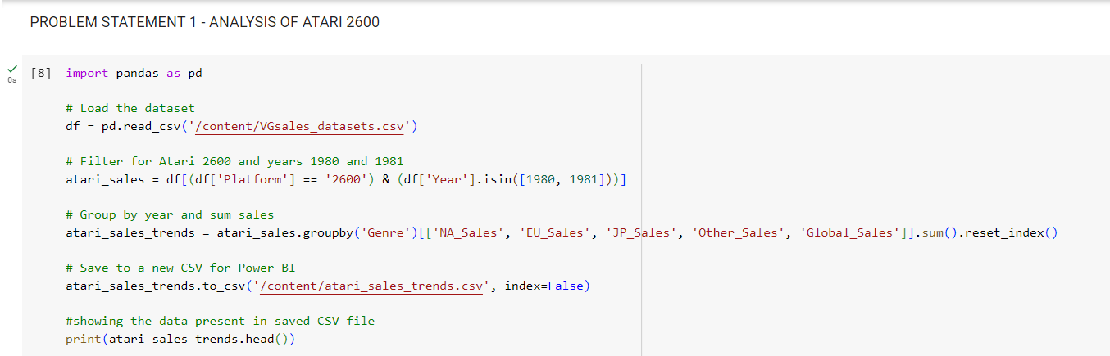
Code

Slide 8
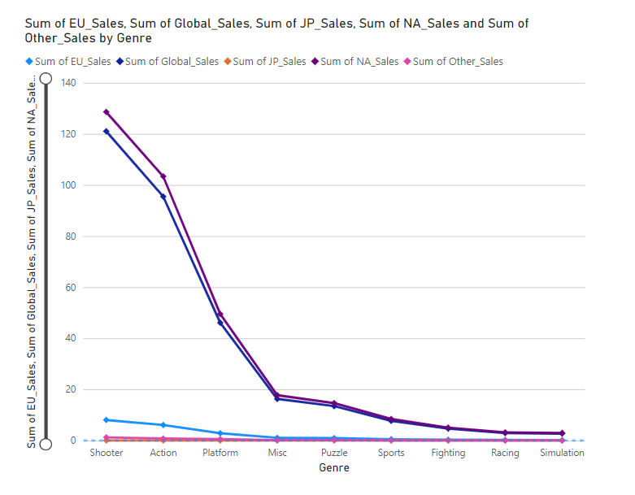
Figures/Graph

Slide 9
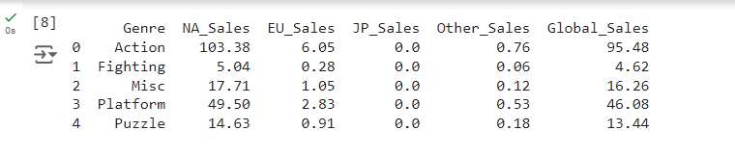
Results(Screenshot)

Slide 10
PHASE 2 - Data Ingestion and Storage Optimization

Slide 11
Problem Statement - 5
Genre-Specific Sales in Japan

Slide 12
Description
The aim of the problem statement is to extract records for genres where video game sales were higher in Japan than in Europe.
We save these records in a CSV file named ‘JP_Sales.csv’.
We use python to analyze the contribution of different genres to sales in various regions.
Using df function that helps using the dataframe to compare the Japan and Europe sales
Saving this file to JP_Sales csv file
Using python to create a visualization for better analysis

Slide 13
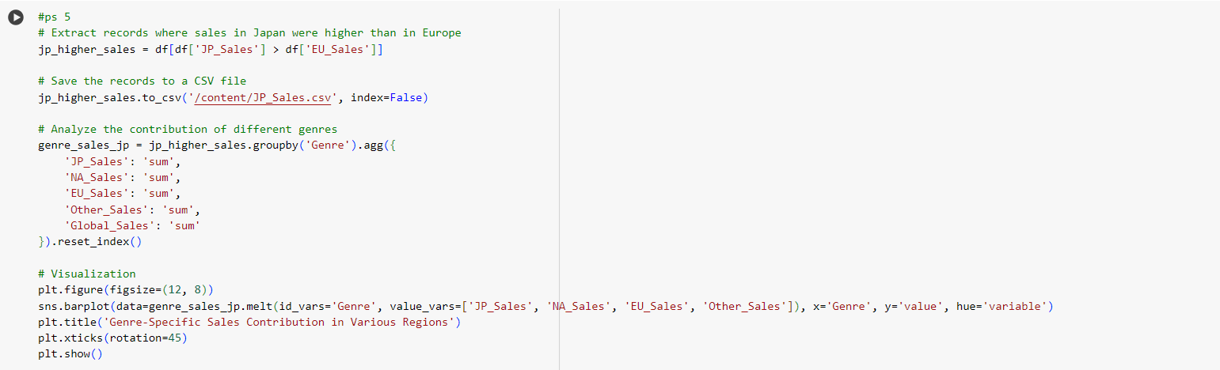
Code

Slide 14
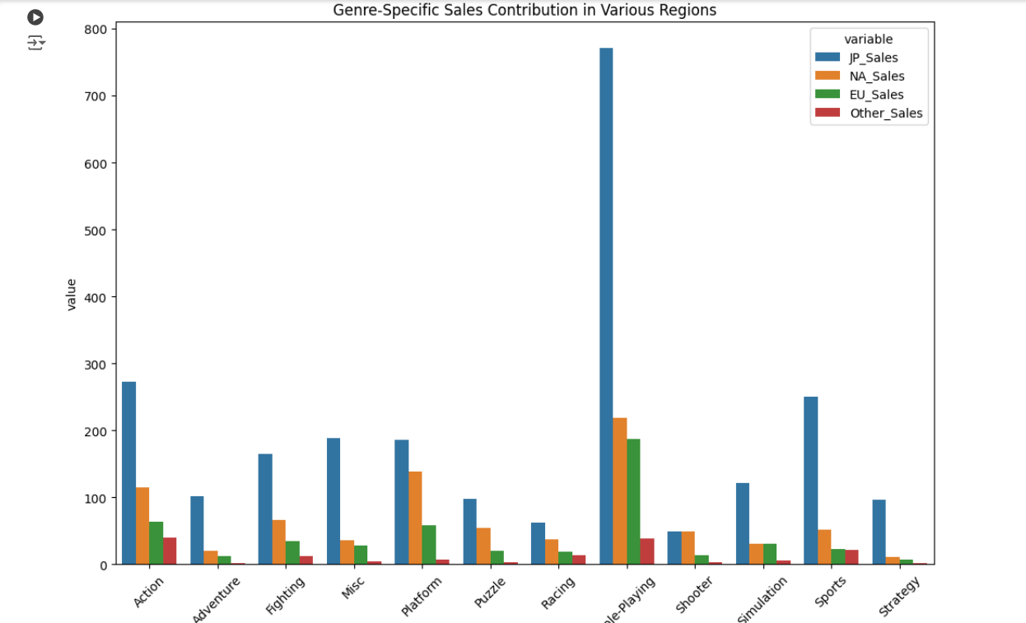
Figures/Graph

Slide 15
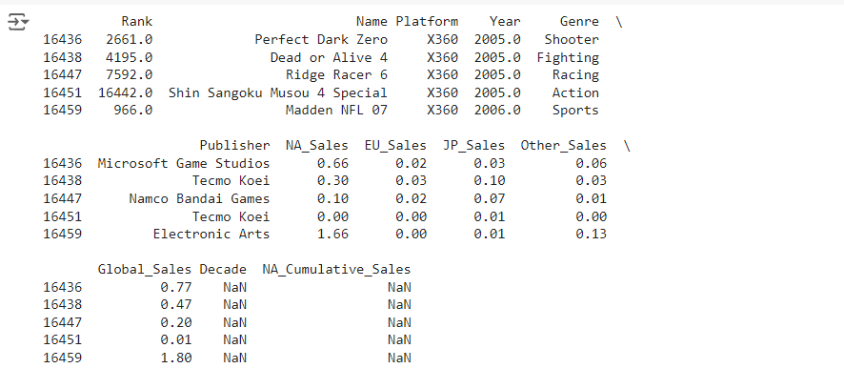
Results(Screenshot)

Slide 16
Problem Statement - 7
Post-2010 Sports Games Analysis

Slide 17
Description
The aim of the problem statement is to extract records for sports games in the action or shooter genres since 2010.
Using python , we visualize the distribution of global sales
Extracting all the records for the genre as sports by checking the genre as action or shooter along with the year being 2010
Using seaborn and matplotlib for visualization

Slide 18
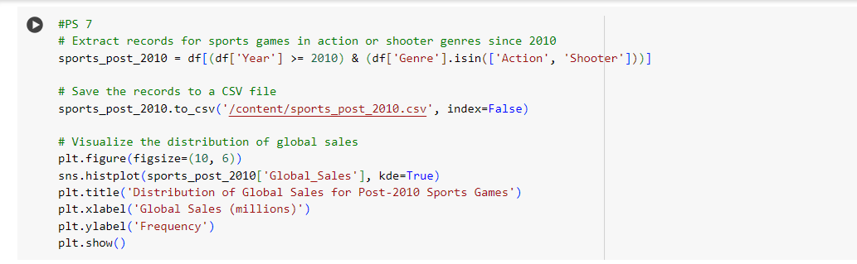
Code

Slide 19
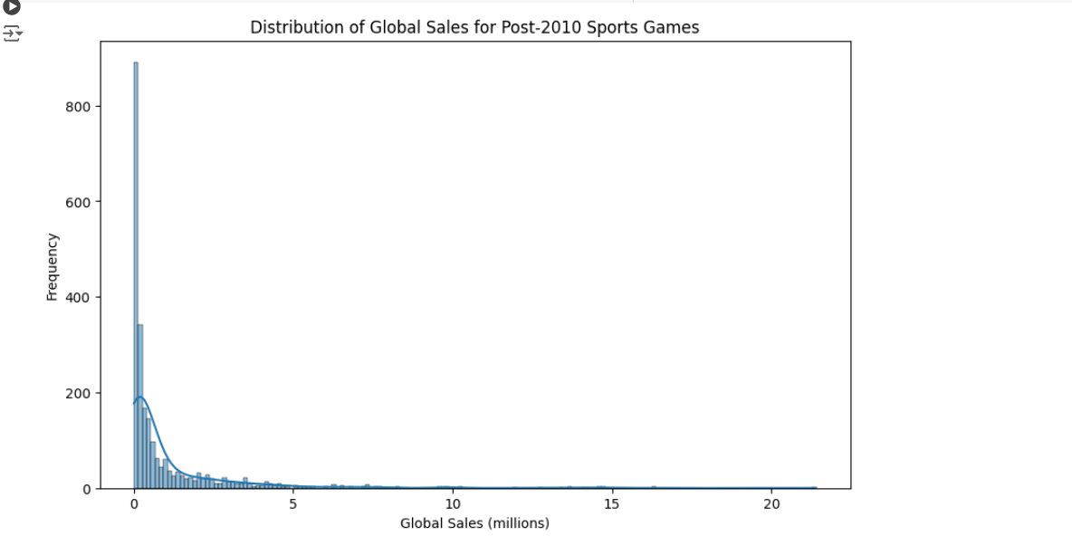
Figures/Graph

Slide 20
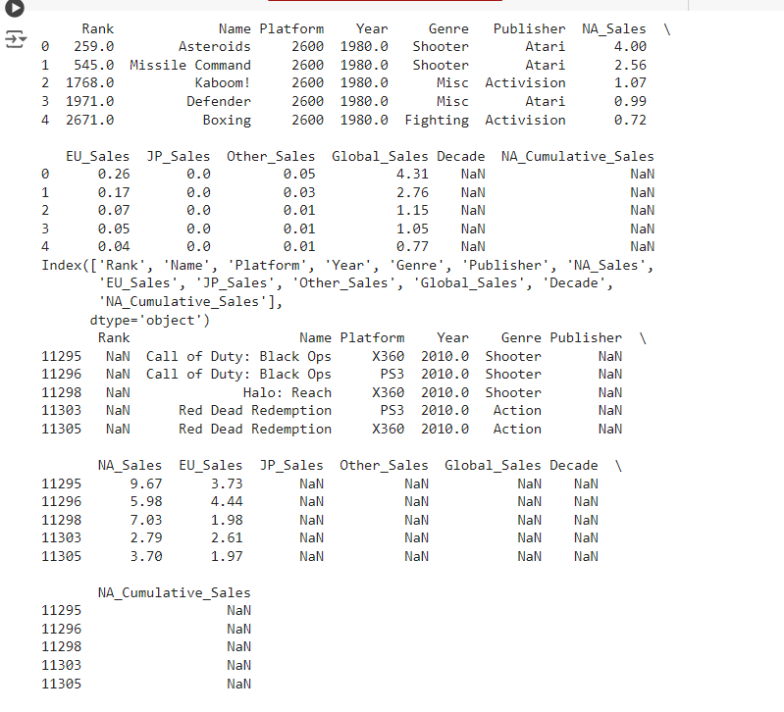
Results(Screenshot)

Slide 21
PHASE 3 - Data Transformation

Slide 22
Problem Statement - 9
High Sales Genres

Slide 23
Description
We create a CSV file with records for sports, action, and shooter genres with global sales greater than 2 million.
We exclude genres such as puzzle, fighting, and racing.
Filtering genres and global sales that is more than 2 million
Saving the changes into new csv file named “high_sales_genres”
Using seaborn and matplotlib to visualize the transformed data

Slide 24
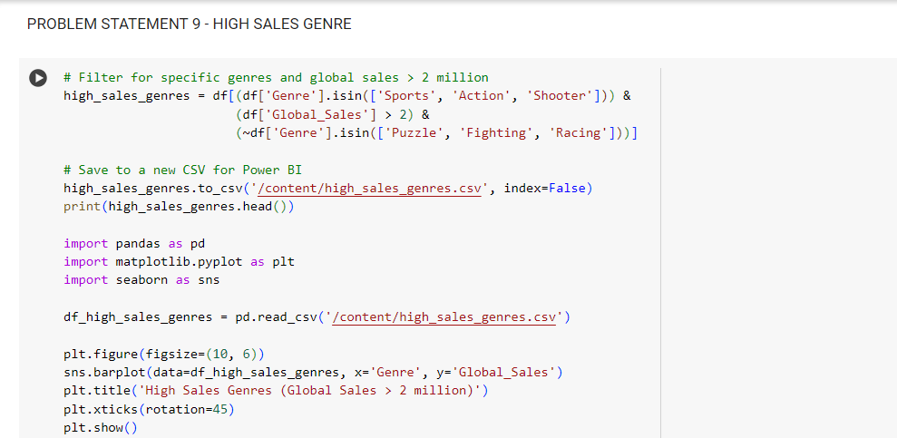
Code

Slide 25
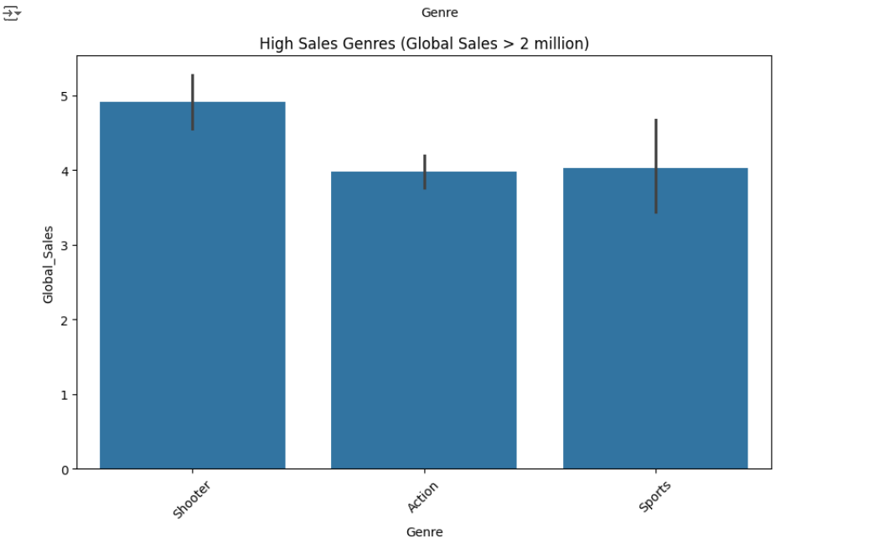
Figures/Graph

Slide 26
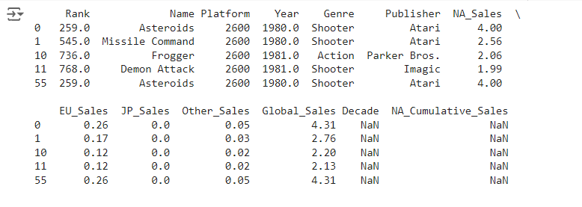
Results(Screenshot)

Slide 27
PHASE 4 – Data warehousing and visualization

Slide 28
Problem Statement - 12
Racing Genre Sales Analysis

Slide 29
Description
The goal of the problem statement is to extract records for the racing genre with the highest EU sales between 2000 and 2009, where EU sales are greater than JP, NA, and other sales.
Then we save these records in a CSV file named ‘racing_eusales.csv’. Extract the top 5 EU sales records for 'Name' and 'EU Sales', setting 'Name' as the index.
Filter for racing genre and years 2000-2009
Data wherever EY_Sales > JP.NA and Other_sales
Getting the top 5 records for EU_Sales
Saving the data into csv file

Slide 30
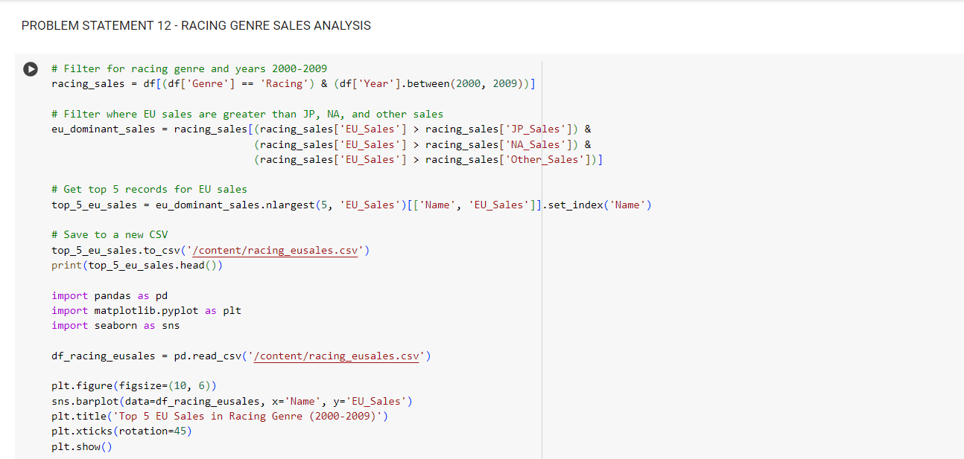
Code

Slide 31
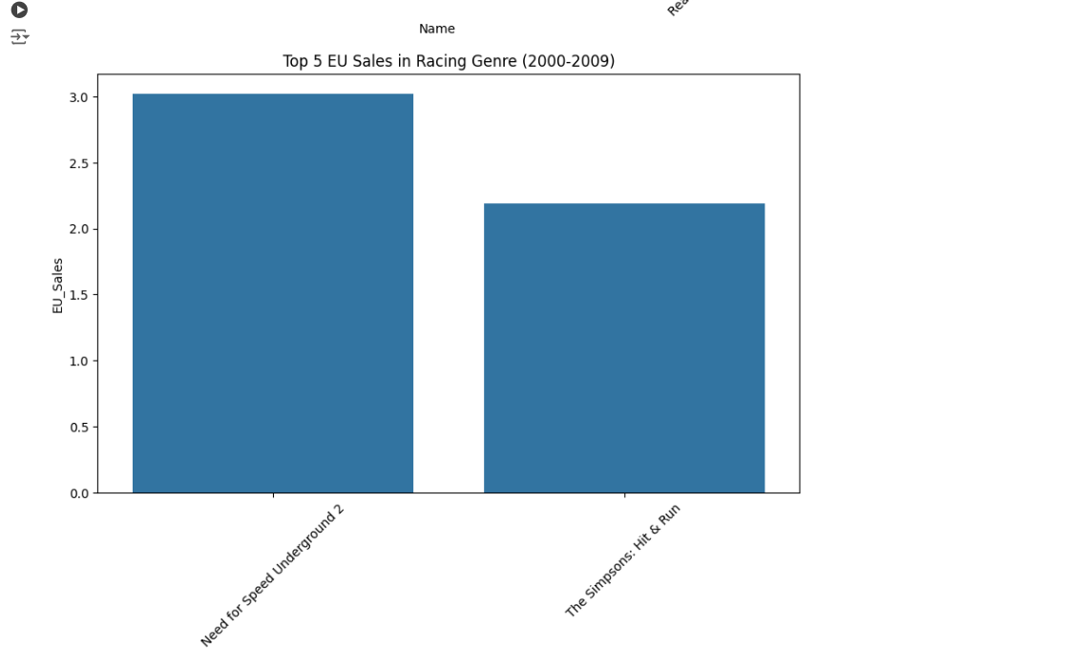
Figures/Graph

Slide 32
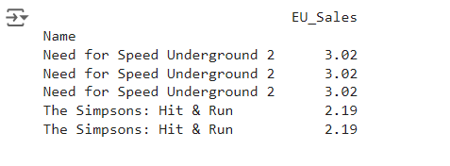
Results(Screenshot)

Slide 33
FINAL PHASE - Reporting and Visualization

Slide 34
Problem Statement - 15
Feature Impact on Sales

Slide 35
Description
The goal is to analyze the impact of specific game features on the sales performance of Atari 2600 games.
We use genre or publisher as proxy indicators if feature data is unavailable.
Filtering for Atari 2600 platform
Group by genre and publisher to analyze their impact on sales
Saving the transformed data into a new csv file named “feature_impact.csv”

Slide 36
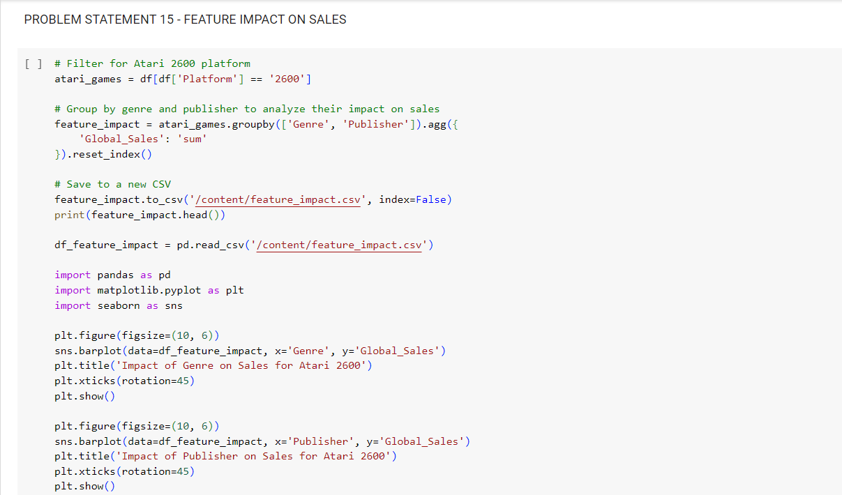
Code

Slide 37
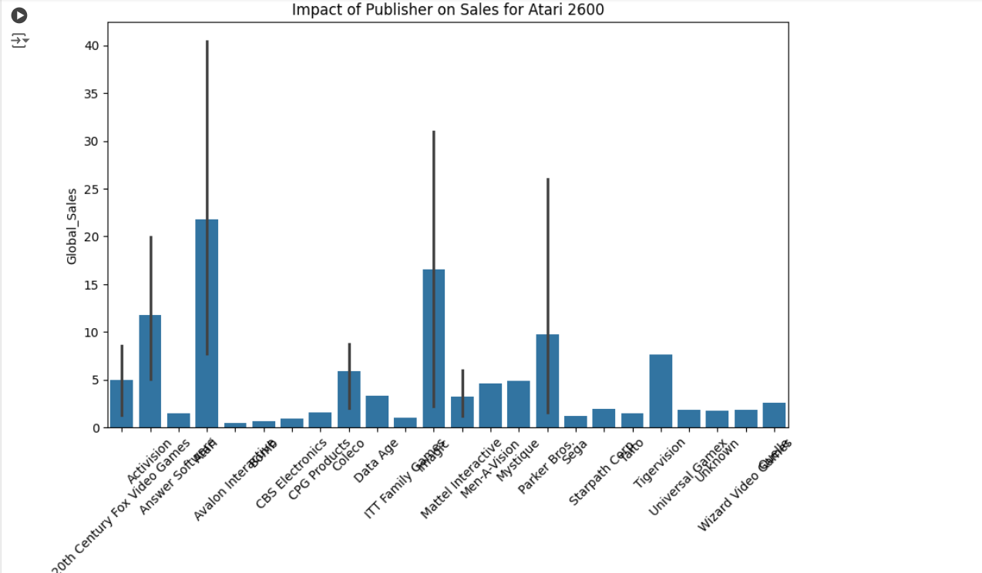
Figures/Graph

Slide 38
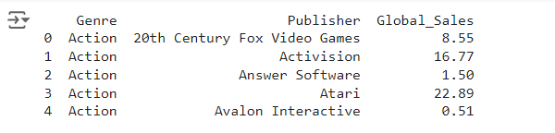
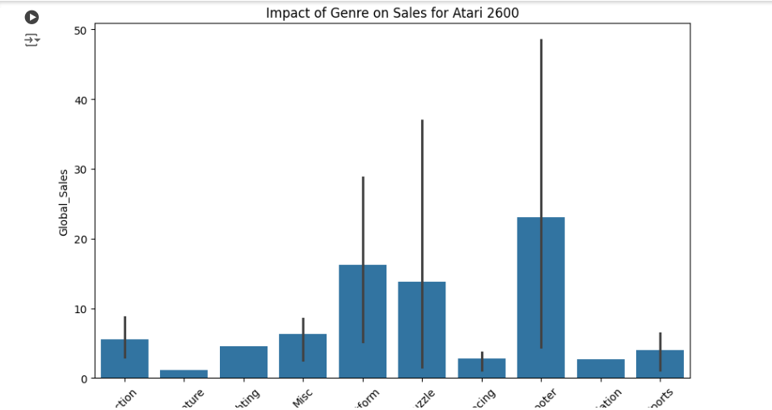
Results(Screenshot)

Slide 39
Conclusion
The Video Game Analysis Project aimed to provide a comprehensive understanding of video game sales data through a structured, phased approach. Each phase focused on different aspects of data analysis, from initial data cleaning and preprocessing to advanced data transformation, warehousing, and visualization.
The key Insights and Business Implications we platform popularity , regional preferences, trends throughout the years , factors that impact on the sales like publisher and game developers demands etc.
Tools and Technologies
Python: For data cleaning, transformation, and analysis.
Power BI: For creating interactive dashboards and visualizations.
Matplotlib & Seaborn: For detailed data visualizations

Slide 40
References
[1] | X. Chu, I. F. Ilyas, S. Krishnan, and J. Wang, “Data cleaning: Overview and emerging challenges,” in Proceedings of the 2016 International Conference on Management of Data, 2016.
[2] | J. VanderPlas et al., “Altair: Interactive statistical visualizations for python,” J. Open Source Softw., vol. 3, no. 32, p. 1057, 2018.
[3] | E. L. Fink, “The FAQs on data transformation,” Commun. Monogr., vol. 76, no. 4, pp. 379–397, 2009.
[4] | S. Chaudhuri and U. Dayal, “An overview of data warehousing and OLAP technology,” SIGMOD Rec., vol. 26, no. 1, pp. 65–74, 1997.
[5] | W. McKinney, Python for Data Analysis: Data wrangling with pandas, NumPy, and IPython. “O’Reilly Media, Inc.,” 2012.
[6] | S. Tosi, Matplotlib for Python developers. Birmingham, England: Packt Publishing, 2009.
[7] | M. Waskom, “seaborn: statistical data visualization,” J. Open Source Softw., vol. 6, no. 60, p. 3021, 2021.

Slide 41
Thank you!!!

